Slide 1
Using Reference Managment Tools: Endnote and Zotero
Diarmuid Stokes University College Dublin

Slide 2
What is reference management software ?
Reference management software, citation management software or personal bibliographic management software is software for scholars and authors to use for recording and utilising bibliographic citations (references). Once a citation has been recorded, it can be used time and again in generating bibliographies, such as lists of references in scholarly books, articles and essays. (Wikipedia)
Reference management software. (2014, April 10). In Wikipedia, The Free Encyclopedia. Retrieved 14:20, April 22, 2014, from http://en.wikipedia.org/w/index.php?title=Reference_management_software&oldid=603615486

Slide 3
What’s it good for?
Write article or book
Work collaboratively
Share references
Curate collection of references

Slide 4


























Reference Management Tools

Slide 5













Free Reference Management Tools*
* May have some limitations.

Slide 6



Today Endnote Web & Zotero

Slide 7
Endnote Web & Zotero Compared
Criteria | Zotero | EndNote Web
Web based? | Yes, works with Firefox browser and can sync with online account; connectors for Chrome and Safari available | Yes
Must be online? | No | Yes
Cost | Free for basic account, some cost for more online storage space | Depends on options
Word-processor compatibility | MS Word, LibreOffice, Google Docs | MS Word
Import from databases | Yes | Yes
Import citation info from web pages | Yes, also archives the page and you can add annotations | Yes, with Web Capture tool
Storage capacity | Unlimited local storage and data syncing; 100MB free Zotero file syncing (larger syncing plans available for purchase); or can use WebDav | 50,000 or unlimited
Attach associated files (PDFs, etc.) | Yes, with option to attach automatically | Yes
Search full text of PDFs | Yes | No
Create group or shared libraries | Yes | Yes
Create bibliography with different styles | Yes | Yes
Automatic citation extraction from PDFs | Yes | No
Other features | Sync library with multiple computers Use tags to organize/search | Share Groups with other registered users Ipad and Iphone Apps

Slide 8
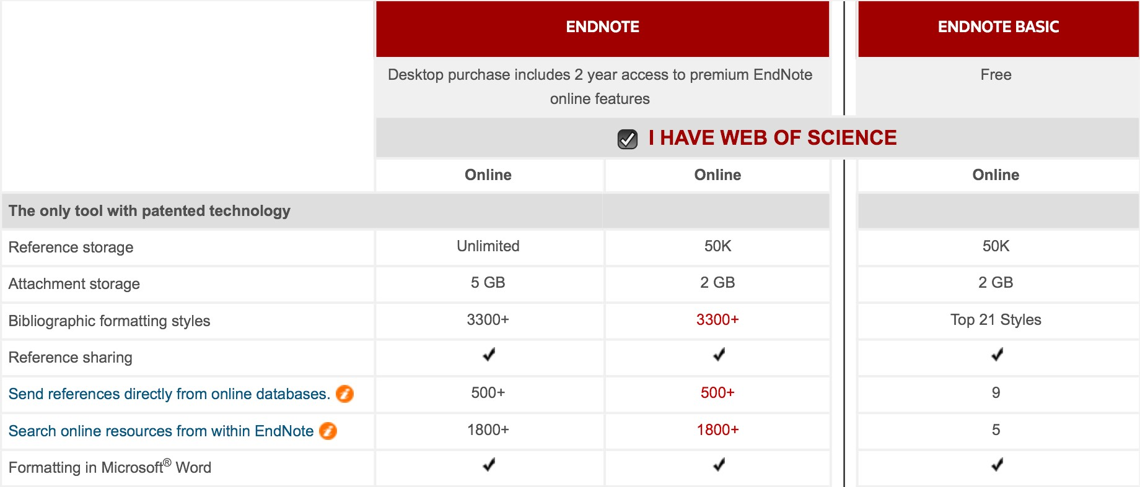
Endnote Web: The options

Slide 9
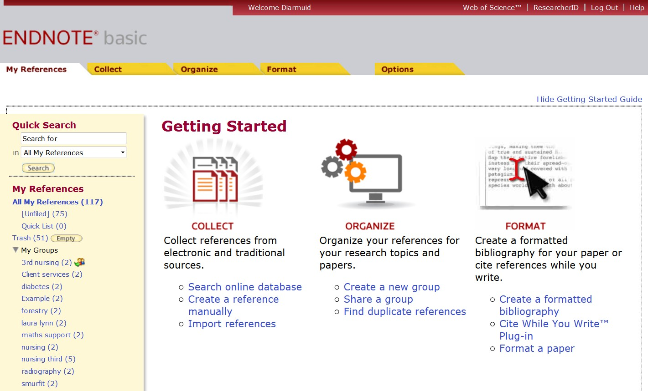
Endnote Web

Slide 10
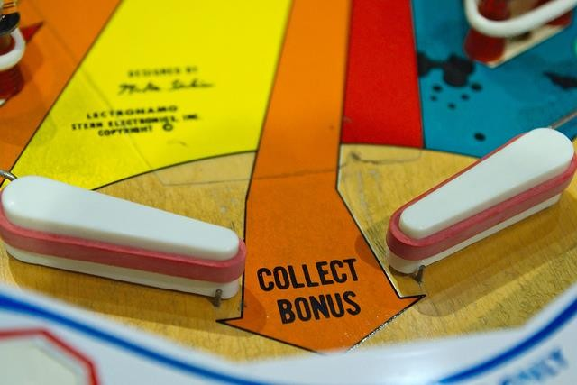
Collecting references
3 ways to bring references onto your library
New Reference to manually create references
Online search to search catalogues and selected databases
Import references to bring references in from databases
‘Collect Bonus’ by Frédéric Bisson, https://www.flickr.com/photos/zigazou76/8522717632/. Licence at http://creativecommons.org/licenses/by/2.0.

Slide 11
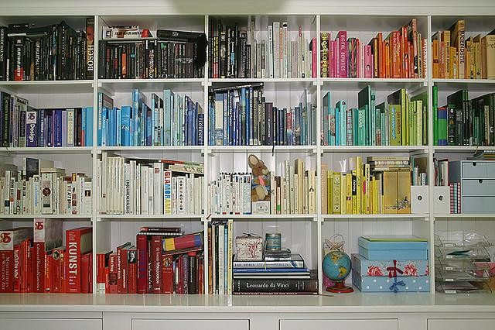
Organising your references
Manage & Share your groups
Locate and delete duplicate references
Manage attachments
‘Done!!’ by Yvonne Eijkenduijn, https://www.flickr.com/photos/yvestown/298760755/. Licence at https://creativecommons.org/licenses/by-nc-nd/2.0/

Slide 12
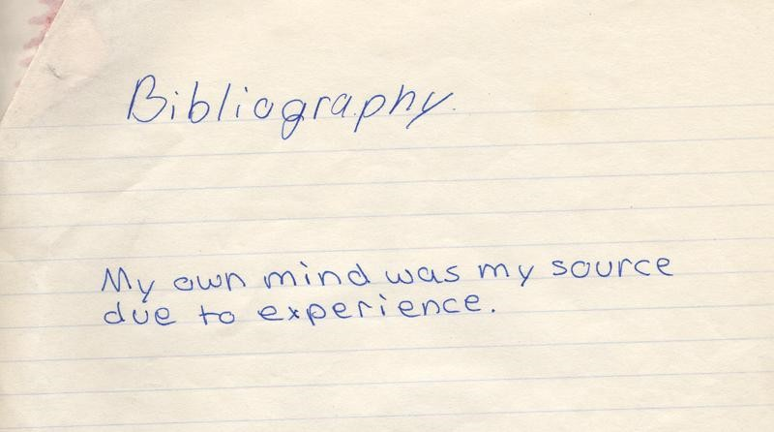
Formatting References
Use Format tab to:
Create bibliographies
Get Cite While you Write
Format Paper
Export references
‘bibliography’ by papertrix, https://www.flickr.com/photos/papertrix/38028138/. Licence at https://creativecommons.org/licenses/by-nc/2.0/.

Slide 13
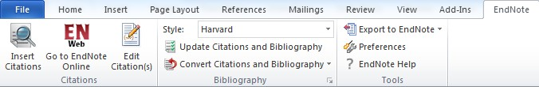
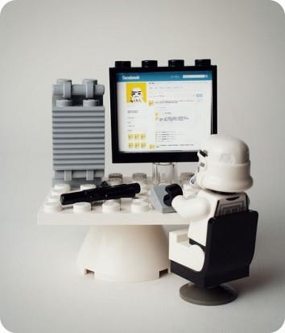
Use the Cite While You Write Toolbar to:
Insert citations
Edit citations
Change referencing styles
Merge documents together
‘Lego on Facebook’ by amarois , https://www.flickr.com/photos/amarois/6731246141/. Licence at http://creativecommons.org/licenses/by-nc-sa/2.0/.

Slide 14

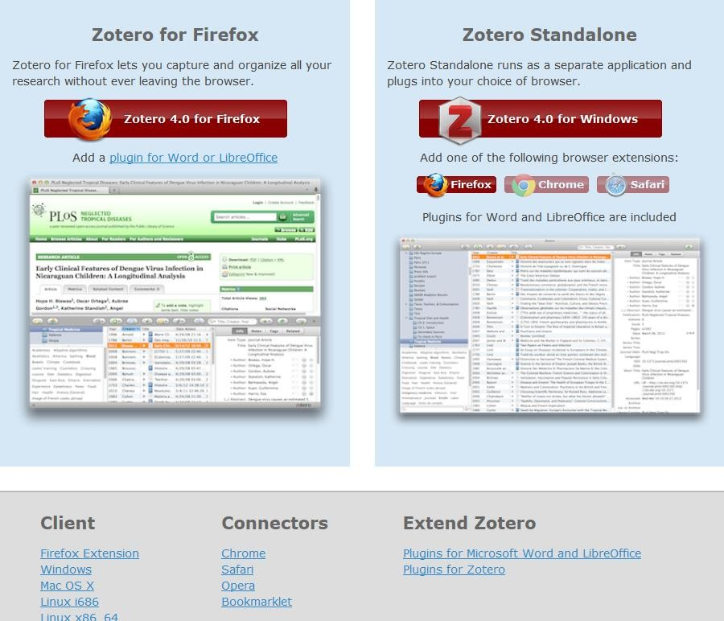

Slide 15
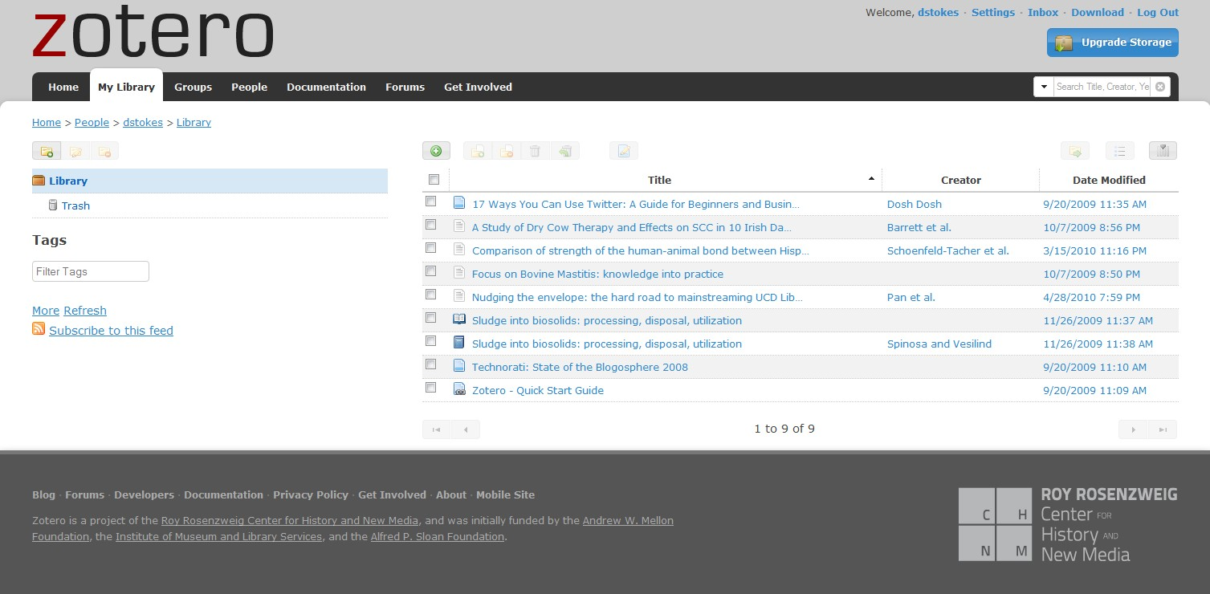
http://www.zotero.org/

Slide 16

Adding References to
Ways to add reference
Manually
via Browser
From Databases
by Identifier
import webpage details
‘Gathering Up the Pine Cones’ by Arielle Nadel, https://www.flickr.com/photos/bunnyrel/7461043566/. Licence at https://creativecommons.org/licenses/by-nc-nd/2.0/.

Slide 17

Organising references in
Manage & Share your groups
Locate and delete duplicate references
Manage attachments
Create Bibliography
‘Life's More Fun When You're Organized’ by Adam Rifkin, https://www.flickr.com/photos/ifindkarma/92240723/. Licence at https://creativecommons.org/licenses/by/2.0/.

Slide 18
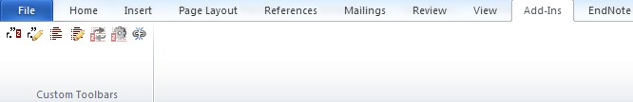
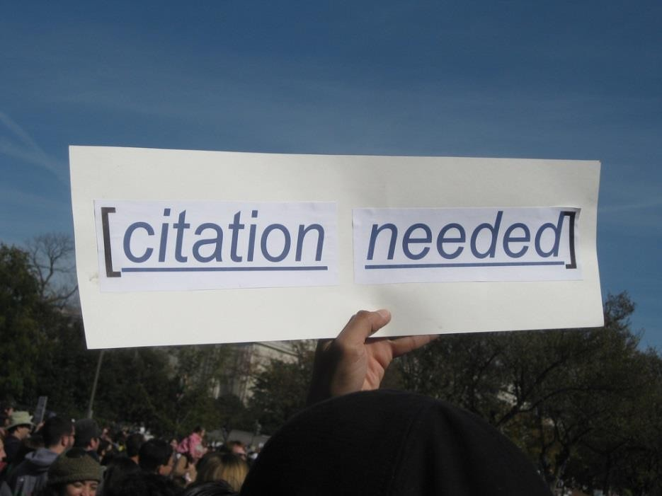
Use the toolbar to:
Insert citations
Edit citations
Change referencing styles
Merge documents together

Slide 19
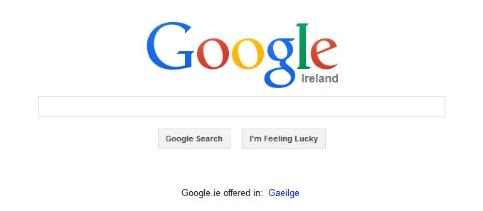
When you need support.
Endnote
http://www.endnote.com
ENDNOTE@JISCMAIL.AC.UK
Zotero
Zotero.org @ZoteroSupport

Slide 20

Who wins?
‘Winner’ by Kreg Steppe, https://www.flickr.com/photos/spyndle/2500303479/. Licence at https://creativecommons.org/licenses/by-sa/2.0/

Slide 21




Thank you
Diarmuid Stokes - Liaison Librarian, UCD
Diarmuid.stokes@ucd.ie
http://www.ucd.ie
@dstokes01
01 7166572

Slide 22
styles and connections available within Endnote Basic
Connections available within Endnote Basic | Styles available within Endnote Basic
PubMed (NLM) British Library Library of Congress Crossref Lista (EBSCO) | BNT (Author--‐Date) ABNT (Citation--‐Order) ACS Annotate APA 6th Author--‐Date Chicago 16th Footnote Chicago 16th Author--‐Date Cite Them Right--‐Harvard CSE Style Manual C--‐S CSE Style Manual N--‐Y IEEE JAMA MLA NLM Numbered Refman RIS Science Turabian Bibliography Turabian Reference List Vancouver

